Slide 1



HunrenTech Interactive Conference –
Impact Meets Science
Budapest, Hungary
14 April 2026
Keynote:
Tech, IP and Finance – The New “Rules of the Game” for National Growth and Relevance
Audrey Yap
IP Lawyer · Patent Attorney · IP Strategist
Regional Managing Director, Yusarn Audrey LLC

Slide 2
Agenda
Singapore Malaysia Thailand
Introduction
Emerging Technologies
Global Statistics
Connecting the Dots with IP
Developments Around the World
The Hungarian Perspective
Global IP Trends
Key Takeaways

Slide 3




Technology Evolution
Singapore Malaysia Thailand
Engine and Transport
Biopharma
ICT
Digital
Tech
1895 to 1925
1930 to 1960
1965 to 2000
2000 to 2020

Slide 4
Emerging Trends
Singapore Malaysia Thailand
Disruptions; addressed by:
technology – rise of smart factories leveraging of automation and robotics, IoT, digital twins, Industry 4.0, 5.0 advanced, analytics, artificial intelligence (AI), acceleration of biotech, medtech
new objectives – netzero, sustainability, ESG
explosion of data

Slide 5
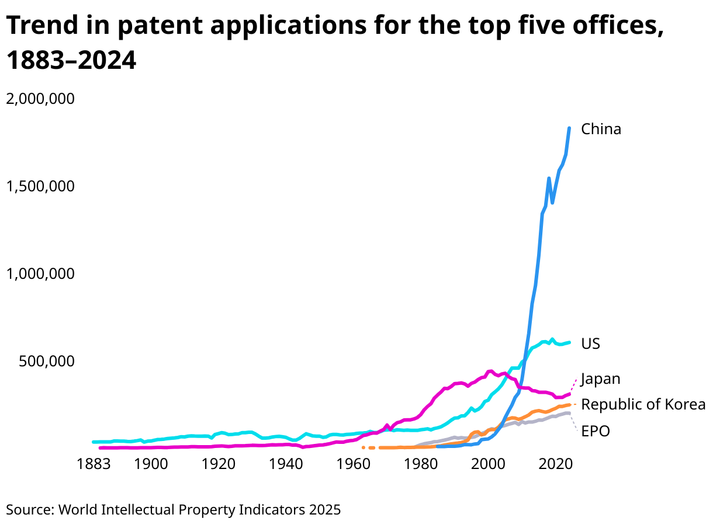
Historical Trends in Patents
Across the Years
Singapore Malaysia Thailand

Slide 6
Global Statistics
Singapore Malaysia Thailand
Top Technologies | Geographical Specialisation*
Computer Technology (13.2%) | China and USA
Electrical Machinery (7.2%) | Germany, Japan and Korea
Digital Technology / Communication (5.8%) | China, USA, India and Korea
Medical Technology / Pharmaceutical (4.9%) | Israel, Netherlands, Switzerland and USA
* Cross reference Relative Specialisation Index (RSI)
Source: World Intellectual Property Indicators 2025

Slide 7
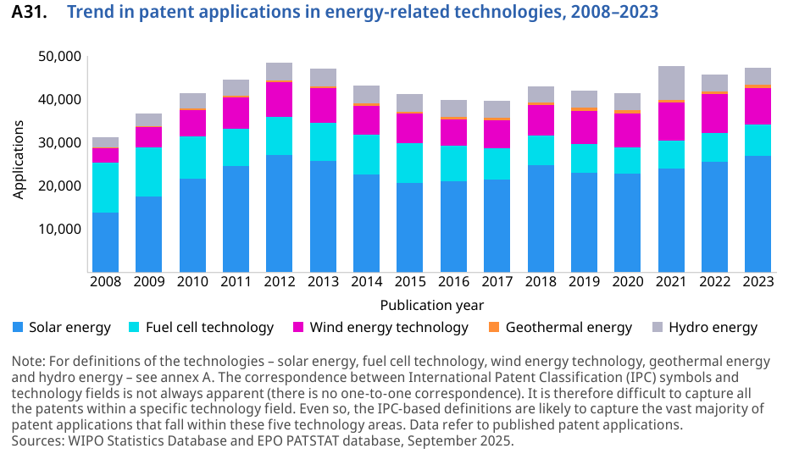
Energy-related Patent Applications
Singapore Malaysia Thailand
Energy Technologies – 47,200 Published Applications
Country Specialisation
Fuel Cell – Japan
Geothermal – Finland, Canada and Sweden
Hydro – Russia
Solar Energy – Singapore and Israel
Wind Energy – Denmark and Spain

Slide 8
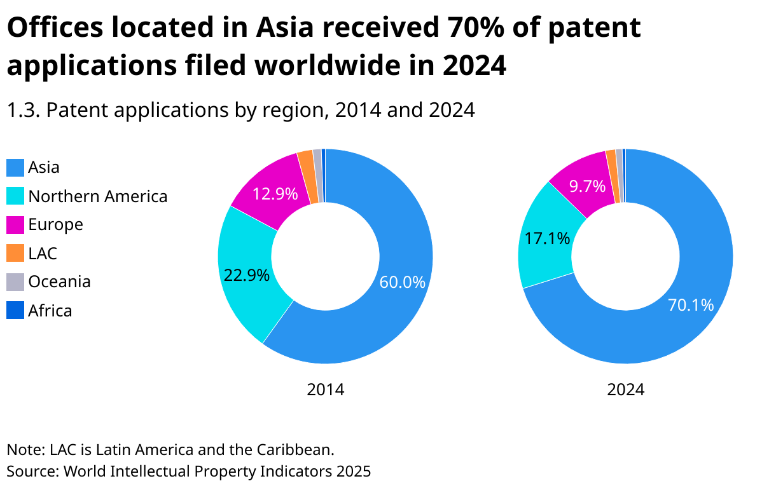
Asia
Singapore Malaysia Thailand

Slide 9
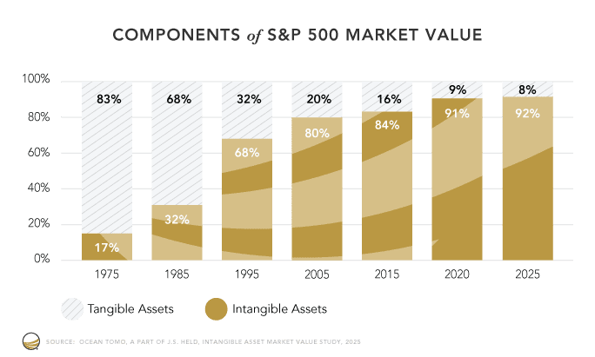
The Great Economic Inversion
Singapore Malaysia Thailand

Slide 10
Intellectual Capital of an Organisation
Singapore Malaysia Thailand
Intellectual Capital
Human Capital
Intellectual
Assets
Intellectual assets chosen for legal protection such as patents, industrial designs and trademarks
Intellectual Property

Slide 11
Intellectual Property
Singapore Malaysia Thailand
So we recognise tech and innovation will continue to play a crucial role in manufacturing. Investments in innovation will allow us to emerge stronger
Intellectual property, in particular patents, under pin the chance at reward for delivering such technology because it allows for and governs the ability to own such technologies
Includes assets that pertain to novel and original creations of human intellect (these may be products, processes, written works, apparatus, formulations, methods of manufacture) protected by patents, copyright or design laws

Slide 12
Types of Intellectual Property
Singapore Malaysia Thailand
IP relevant to secure, protect and allow ownership in innovation and ideas
Require registration and country specific | Patents: inventions, new products, processes, apparatus Designs: look and feel, shape Trademarks: name, logos, slogans
There are those that even though do not require registration, require process and data management | Trade Secrets: proprietary know how, practices, data formulations, information commercially valuable

Slide 13
Connecting the Dots
Singapore Malaysia Thailand
IP and intangible assets are sources of value
Context of use is key for impact
There is intersection between tangible, intangible and financial assets
Co-relation of science and business, IP strategy and creation of value

Slide 14
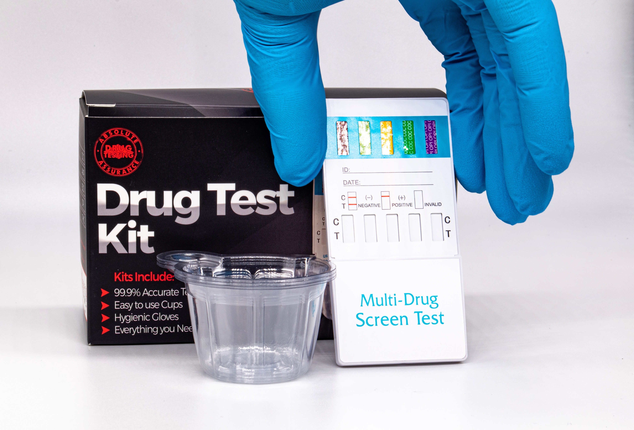
IP Value in Context
Singapore Malaysia Thailand
The Pfizer-BioNTech Case Study
Product company or brand company?
Patents or trademarks?
Understanding the characteristics of the IP category
Don’t forget the importance of trade secrets and know-how

Slide 15
How and Why IP Valuation
(and IP Evaluation) is Helpful?
Singapore Malaysia Thailand
Internal investment calculators
Strategic decision making
Assessment prior to sale
To exploit IP – licensing, equity, spin-off
Calculate damages for IP infringement
IP assets as security

Slide 16
Developments in Asia
Singapore Malaysia Thailand
WIPO-ASEAN IPV Project – January 2023 to 2025
WIPO aims to:
strengthen the ASEAN regional innovation ecosystem
implement projects towards ASEAN IP Rights Action Plan 2016 to 2025, in particular, deliverable 17.2 on best practices on IPV
enhance recognition of the value of IP as a financial asset in the business community
create more transparent IP market relations and environment of trust in IP transactions
All conducted with the support of Japan Industrial Property Global Funds in Trust (FIT)
Completed survey and study on nine ASEAN countries for localised findings; nearly 400 participants across academia, enterprises, financial community and practitioners; largest number of participants from academia and government institutions (37%)

Slide 17
IPV Summary
Singapore Malaysia Thailand
Practitioners | Enterprises | Financial Communities | Academia
Acquisition / Sale of IP Licensing / Litigation M&A Tax | Acquisition / Sale of IP Licensing / Litigation Financial Reporting Management Decision Making | Equity Finance Debt Finance M&A Management Decision Making | Acquisition / Sale of IP Licensing / Litigation Financial Reporting Equity Finance / Debt Finance

Slide 18
The China Story
Singapore Malaysia Thailand
Value of intangible assets in China reach CNY 4.48 trillion (USD 611 billion) in A share companies in 2021, up 17.7% year over year
Notable 94.6% of the companies disclose IP assets in their financial reports
IP pledged lending (patents and trademarks) reached CNY 486.9 billion (USD 67 billion) in 2022
Annual growth rate of these loans between 2016 and 2022 was 28.4%
18,000 businesses benefit from IP financing with average loan of USD 1.4 million

Slide 19
The Hungarian Perspective
Singapore Malaysia Thailand
IP Rights in Numbers
Security Interest in IP
IP as Economic Assets

Slide 20
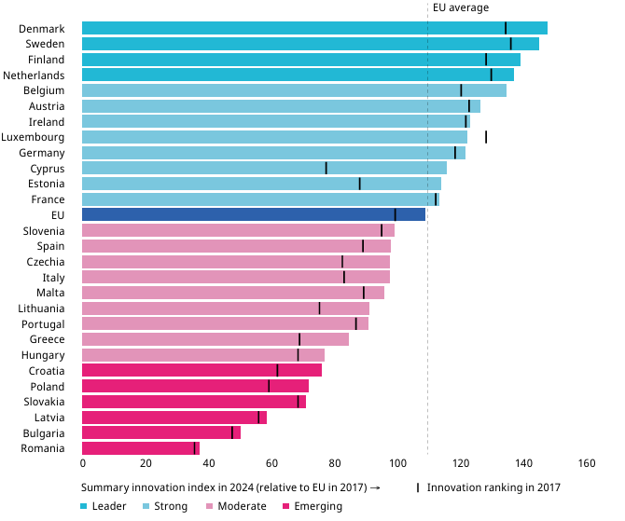
Performance of EU Member States’
Innovation Systems (2017 to 2024)
Singapore Malaysia Thailand

Slide 21
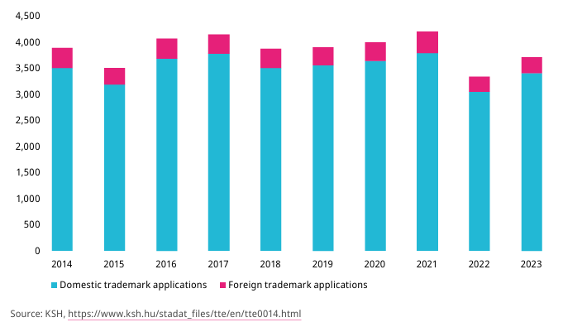
Number of National Trademark
Applications (2014 to 2023)
Singapore Malaysia Thailand

Slide 22
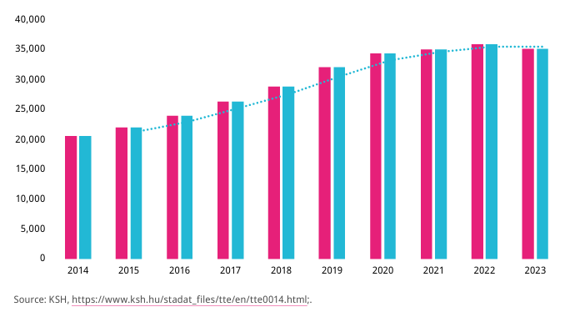
Number of Patents in Force
(2014 to 2023)
Singapore Malaysia Thailand

Slide 23
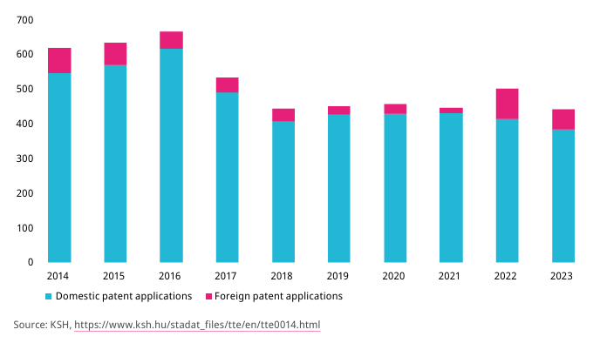
Number of National Patent
Applications (2014 to 2023)
Singapore Malaysia Thailand

Slide 24
Why the Rise of IP Filings?
Singapore Malaysia Thailand
It’s all about intangible assets, value capture in global value chains
It’s about owning IP to enable higher prices, larger profit margin, volume sales, worldwide
It’s about exclusivity of use, dominant designs, strong IP strategies and implementation
It’s about leveraging the IP for financing and access to finance

Slide 25
Global Trends
Singapore Malaysia Thailand
IP Financing
Access to Funds
Capital Markets for Global Growth

Slide 26
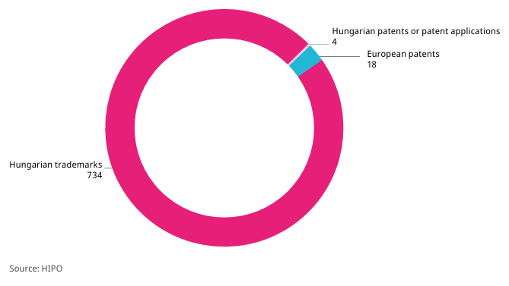
Total Unique IP Rights in Force
Encumbered with One or More
Security Interest (June 2023)
Singapore Malaysia Thailand

Slide 27
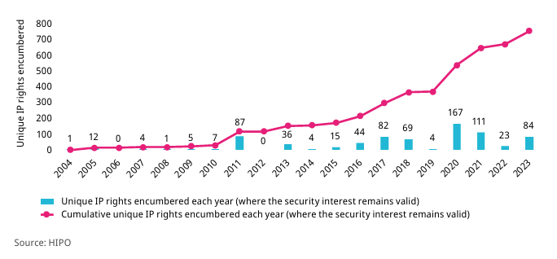
Unique IP Rights Encumbered Each Year
(Where the Security Interest Remains
Valid in June 2023) (2004 to 2023)
Singapore Malaysia Thailand

Slide 28
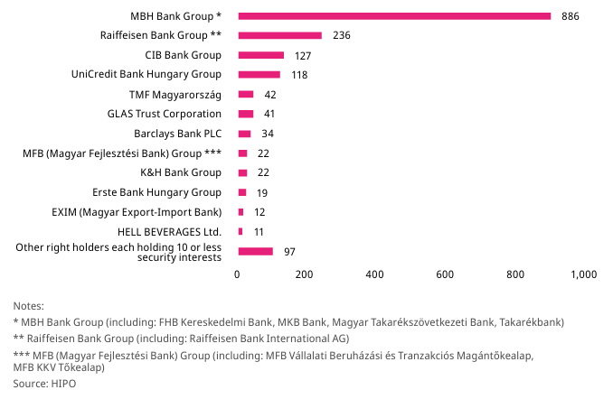
Top Holders of Security Interests
Over IP Rights Valid in Hungary
(as of June 2023)
Singapore Malaysia Thailand

Slide 29
Building an IP Portfolio
Singapore Malaysia Thailand
Tips for building an IP portfolio around your key assets:
Get protection, whatever form it might take
Misconception that it can wait because its expensive. At what cost?
When copied, and you need to take action, it may be too late
Think of this early in product life cycle to have legal basis to act against infringers (particularly competitors); consider how business or product may change in future and anticipate protection
YOUR INVENTIONS AND IDEAS ARE VALUABLE
– TREAT THEM AS ECONOMIC ASSETS
INVEST WISELY IN THEIR PROTECTION AND GET
THE COMPETITIVE ADVANTAGE YOU DESERVE

Slide 30
Key Takeaways
Singapore Malaysia Thailand
Technology, IP and finance are strongly interrelated
Emphasis and harnessing of innovation in IoT, advanced analytics, automation, predictive maintenance, digital twins, and smart factories is reflected in IP statistics and there is a geographical significance
Recognise IP assets in these trends, acquire them, and harness them. Leverage them for value release – financing and other monetisation mechanisms, in particular, licensing of IP

Slide 31
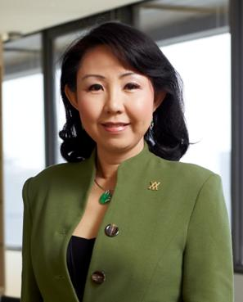

About the Speaker
Singapore Malaysia Thailand
Audrey Yap
Managing Director, Yusarn Audrey LLC
LL.B. (Hons) LL.M.
Advocate and Solicitor, Supreme Court of Singapore
Advocate and Solicitor, High Court of Malaya
Solicitor, England and Wales
Registered Patent Attorney, Singapore
Registered Trademark Agent, Malaysia
Certified Patent Valuation Analyst
TÜV SÜD Professional Singapore Certified Management Consultant
Commissioner for Oaths, Singapore
Notary Public, Singapore
Audrey is managing director and co-founder of regional ASEAN firm YUSARN AUDREY LLC headquartered in Singapore with offices in Malaysia and Thailand, and collaboration offices in Philippines and Europe. She specialises in developing robust intellectual property portfolios, intellectual property valuation, intellectual property financing, and commercial transactions. She is also a certified patent valuation analyst, and TÜV SÜD Professional Singapore Certified Management Consultant helping MNCs, SMEs, and government agencies build and monetise intellectual property portfolios for global growth.
Audrey previously served on the board of Enterprise Singapore (a key agency under the Ministry of Trade and Industry), and is a current board member of the Singapore Food Agency under the Ministry of Sustainability and the Environment. She is also a non-executive non-independent director in a SGX listed food manufacturing company.
She served as board member of the Intellectual Property Office of Singapore (IPOS) from 2015 to 2022 helping design the IP Hub MasterPlan. Audrey is currently chairman of Singapore Innovation and Productivity Institute Pte. Ltd. and is vice president of Singapore Manufacturing Federation.
Audrey was appointed to the joint China Council for the Promotion of International Trade / China Chamber of International Commerce Intellectual Property Committee. She was lead expert for the WIPO ASEAN intellectual property valuation project from January 2023 to March 2024.

Slide 32
Singapore Malaysia Thailand
THANK YOU!
Audrey Yap
Yusarn Audrey LLC
audrey@yusarn.com
enquiries@yusarn.com
www.yusarn.com

