Slide 1
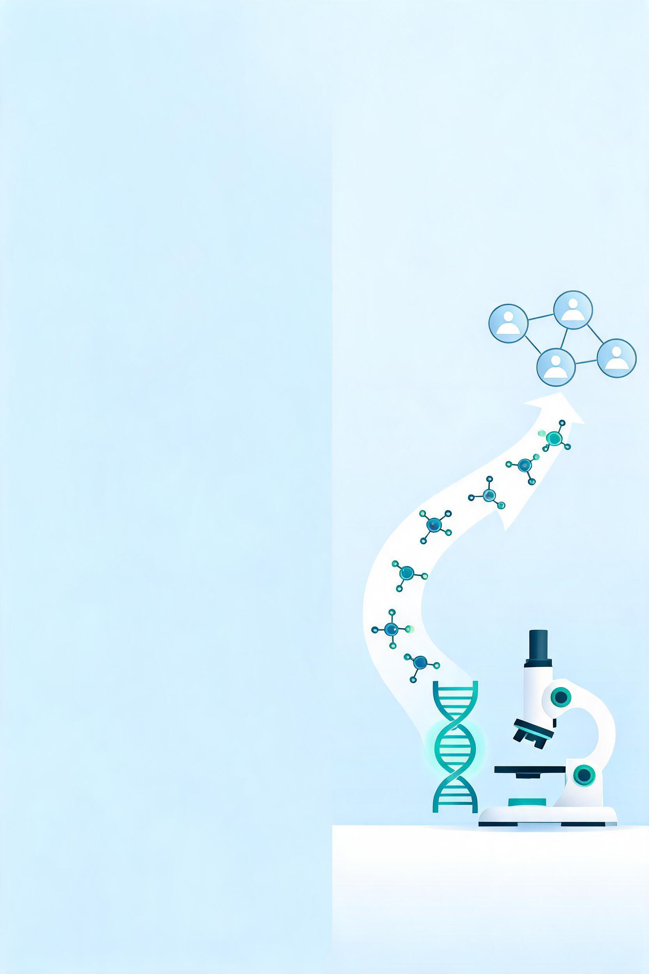

Spin-offs and Investors in Biotech
SZBK – 02.06.2026

Slide 2


Scientific And Business Way Of Thinking Is Entirely Different
Want to know
Strong evidence
Details, complex systems, explaning all miniscule phenomenon
Perfect solution – 5.0
Motivation – Curiosity (Fame)
Autonomy, individual work
Nature
Need to know
Delay is worse than a bad decision
Important things only, save me from details
“Good enough” – Beta version
Motivation – Problem solving, beating competition and greed
Team work, duty delegation
Money

Slide 3
Startups Matter… Matter a Lot
Publications do not cure patients
Innovations do not happen on their own
Valley Of Death – need investors
Investors invest only in companies

Slide 4
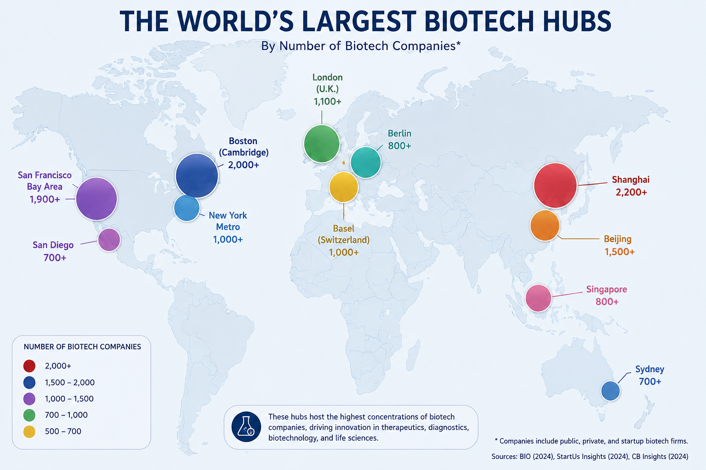
Biotech Is One Of The Most Active Ecosystems
94,000+ companies
9 million employees
57K founding rounds by 11K investors
257K (!!!) med- and biotech patents (2024)
68 Companies raised over USD 100 million in 2024

Slide 5



You Have Three Ways To Go
Publish
  Academic fame
  No impact
License
  Lower risk
  No control
  Early, but limited revenue
Startup
  Highest impact
  Highest risk
  Need investor

Slide 6
Publishing And Inventing Are NOT Mutually Exclusive
COMMERCIALISATION
Ambidextrous Scientists:
Likely professors
Extensive collaboration with other institutes
Connections to industry
Connections to investors
SOCIAL CAPITAL IS HIGH
High
Low
P
U
B
L
I
C
A
T
I
O
N
S
Ambidextrous
Scientist
4,2%
Impactful scientist
27,4%
High
Commercialising Scientist
6,2%
Normal scientist
62,2%
Low
https://www.researchgate.net/publication/223165658_Are_Patenting_Scientists_the_Better_Scholars_An_Exploratory_Comparison_of_Inventor-authors_with_their_Non-inventing_Peers_in_Nano-science_and_Technology

Slide 7
Sequence Is Key
1st Research Finding
2nd Disclosure
3rd Patent filing
4th Publication
We will manage AND pay
Waiting For Answer…

Slide 8
Does My Invention Qualify For Startup?
Is there a real problem?
Who will pay?
Is the solution significantly better?
What are the alternatives?
Can it be protected?
Can it become a large business?

Slide 9
Team Matters A Lot
Early Stage Team Is Different
Early Stage Team:
  Sound science experience AND work experience
  Regulatory access
  Business advisor (TTC)
Later:
  Management Skills
  Clinical Expertise
  Business Development Skills
  Fundraising skills
BRL!
BRL: Business Readiness Level: Can Somebody Make Money Out Of It?

Slide 10


Problem with TRL – In Which You Invest?
TRL 5
TRL 3
Working prototype
No customer identified
Submitted patent application
No business model
No regulatory knowledge
Early proof of concept
Clear customer
Strong moat
Industry partner
Regulatory strategy

Slide 11
Understanding Investors
3F – Family, friends and fools
Angel
Pre-Seed
Seed
Former entrepreneur/ Executive/Industry expert/Wealthy individual
Look for:
  Team
  Founder quality
  Vision
  Personal trust
“I believe in this team”
Fund / Accelerator / Family Office /Angel
Look for:
  Problem identified
  Initial IP
  Market opportunity
Company is a must – equity stake
“I believe in this opportunity”
Fund
Look for:
  Pre-seed success
Bridging between Big VC”
“I believe this can become big”

Slide 12

But Again… Business Thinking Is Different
What is the problem?
Is it a valid problem?
Is it a big problem?
Is the solution unique?
Can it be protected?
What are the alternatives?
Can these guys do it?
Science does not matter…

Slide 13
Uncomfortable Truth: You Will Be Diluted, But…
Accelerator: 30 Million @30%
VC Fund: 200 Million @40%
VC Fund 2: 600 Million @30%
Enterprise value: 100 Million
Enterprise value: 500 Million
Enterprise value: 2,000 Million
Your share: 60 Million
Your share: 180 Million
Your share: 500 Million

Slide 14
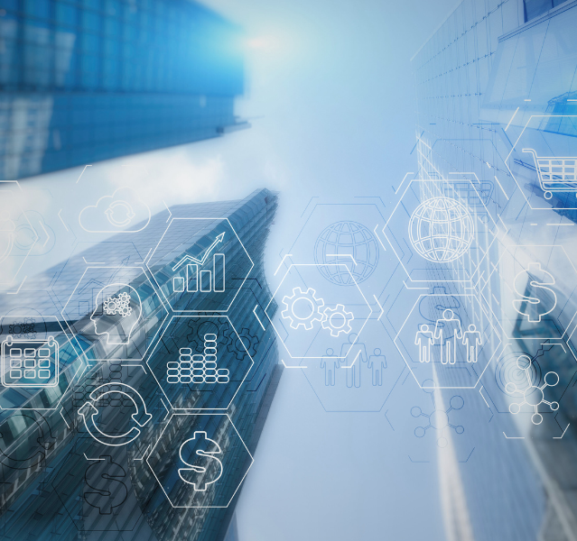
How To Set Enterprise Value At Early Stage? Research Center’s Equity?
Pre-Money / Post-Money
No exact method - all valuations are based on future revenues
Huge differences between methods
Do not do it!
International Best practice:
  Research Center – single digit share
  Driven by policy and NOT negotiations
Early investments – SAFE Method

Slide 15
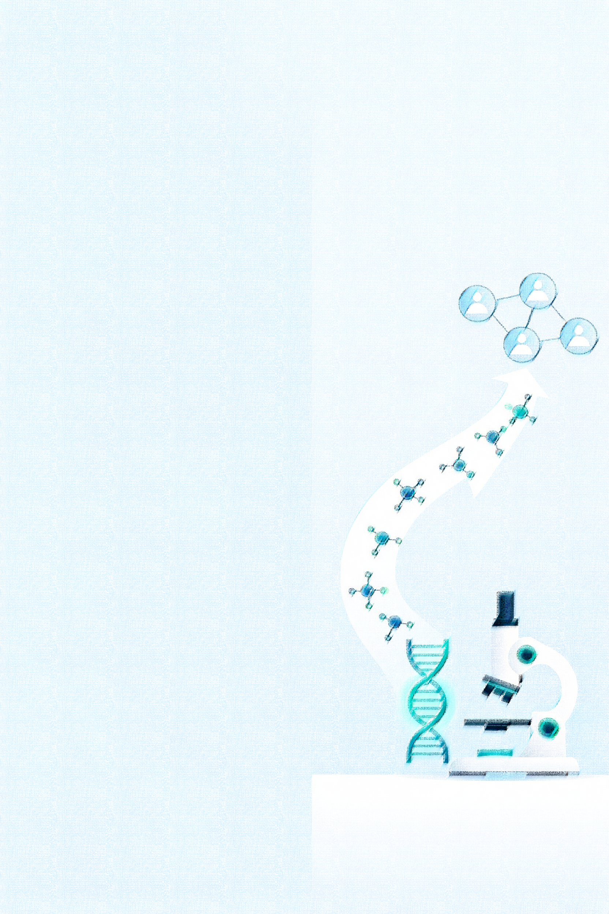
SAFE – Simple Agreement for Future Equity
Investor provides cash
No interest rate
Company DOES NOT immediately issue shares
Shares are issued later when a triggering event occurs
Triggering event: When company value can be set with some degree of accuracy
Example
Accelerator invests 50
NO equity shares are decided
Project goes well, VC Fund wants to participate
VC Fund invests 100 @ 25%
Company value: 400
Accelerator share = 50/400= 12,5%
(It is not this simple, but this is the logic)

Slide 16
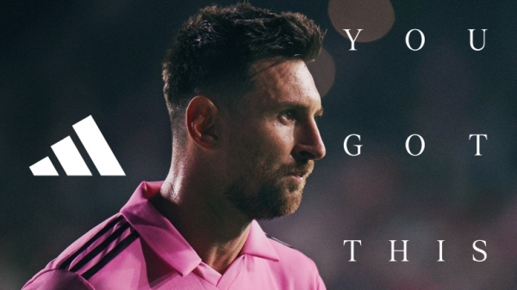
YOU GOT THIS!!!

Slide 17
Business Readiness Level: Can Somebody Make Money Out Of It?
BRL 1: Significant problem identified
BRL 2: Potential customers interviewed and identified
BRL 3: Market fit
BRL 4: Market assessment/Competitor Analysis/Business model
BRL 5: Patent/Freedom-To-Operate assessed
BRL 6: Early pilot – customers engaged
BRL 7: Investor readiness (Series B/C)
BRL 8: Market entry ready
BRL 9: Commercialisation

